Slide 1



From Fortran to Python: A Conversation Across Generations of Scientific Computing
Rodrigo Silva Ferreira, MSc
QA Engineer, Posit PBC
Helianildes Silva Ferreira, PhD
Associate Professor of Chemistry, Federal University of Bahia (UFBA)

Slide 2
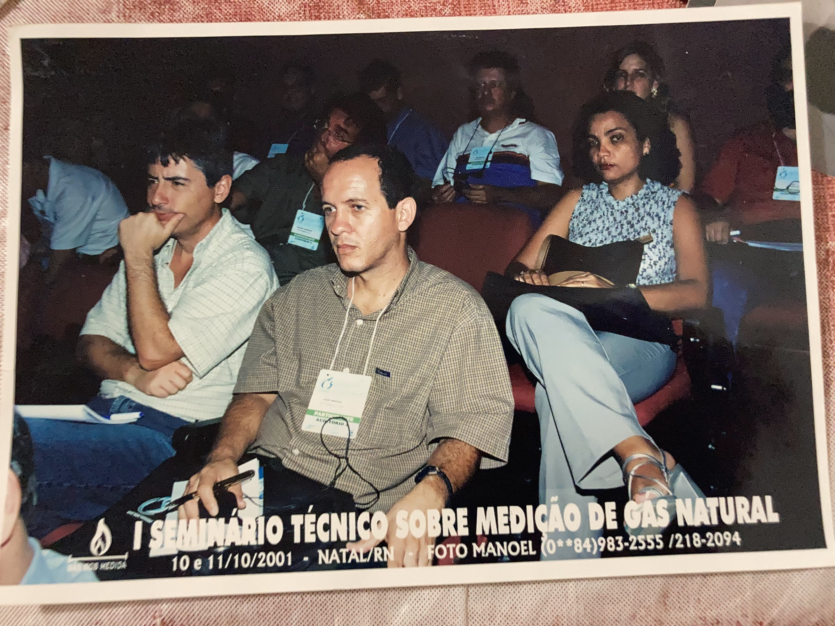


Our Story

Slide 3
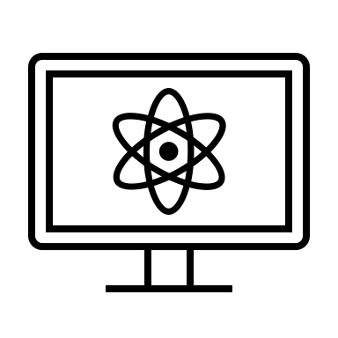



The serpentines of the Py Fortran-lady

Slide 4
Serpentines and protesting bedtime

Slide 5


“I’ll only go to sleep when you finish drawing the serpentines…
…let me help you!”

Slide 6
What were these endless serpentines?
How did they shape our mother-son relationship?
Several years later, Rodrigo finally learned about his mother’s serpentines…

Slide 7
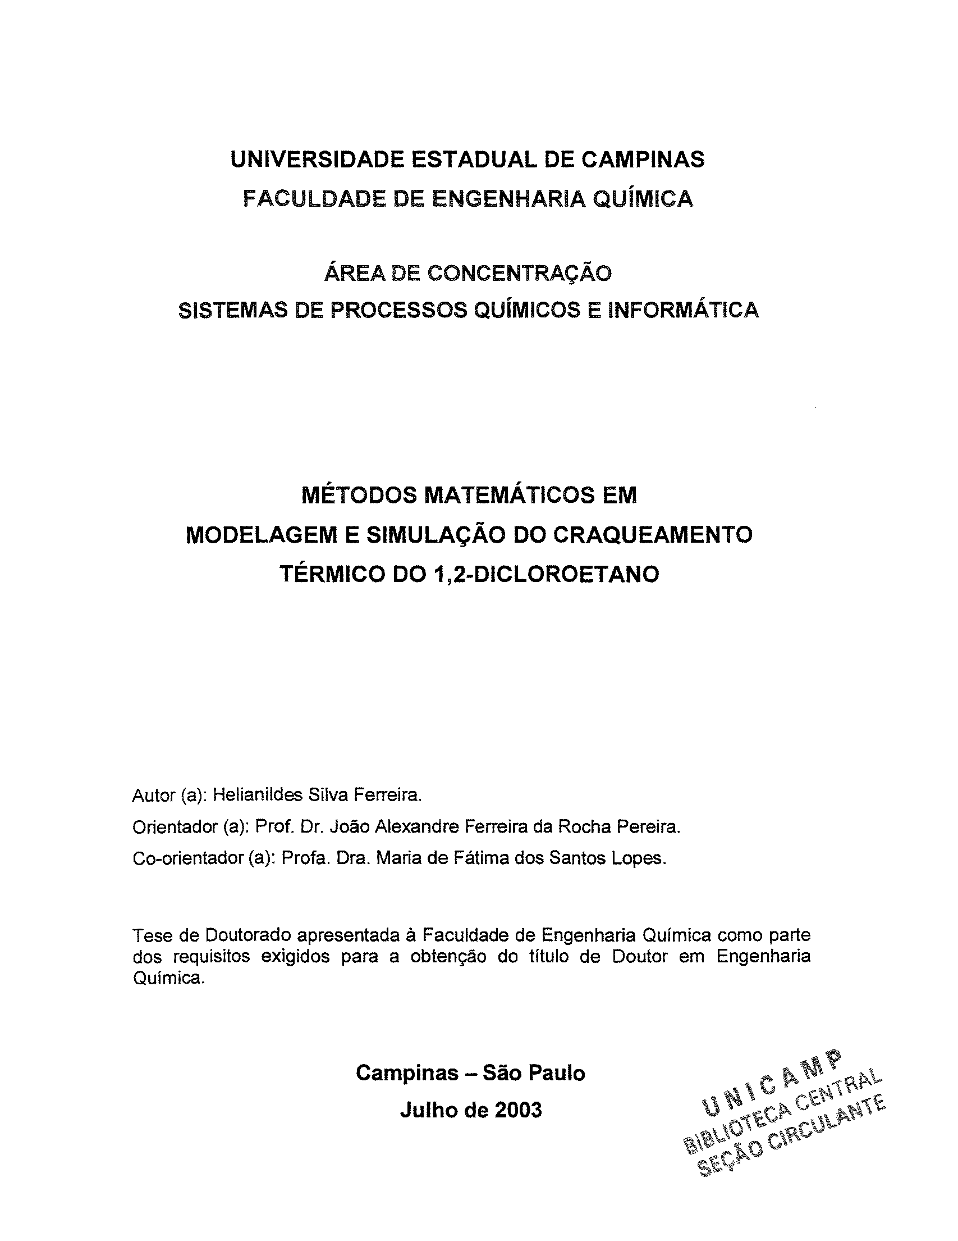

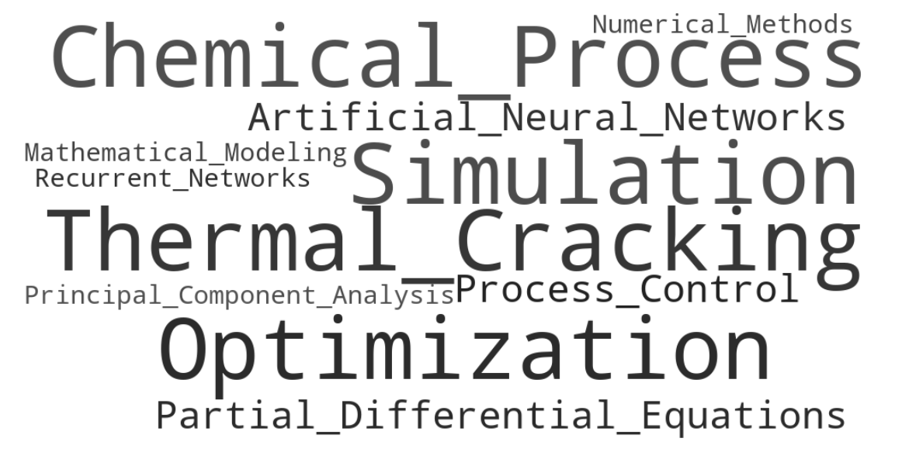
The answer to Rodrigo’s childhood question was in a dusty, spiral book, laying in the storage room.

Slide 8
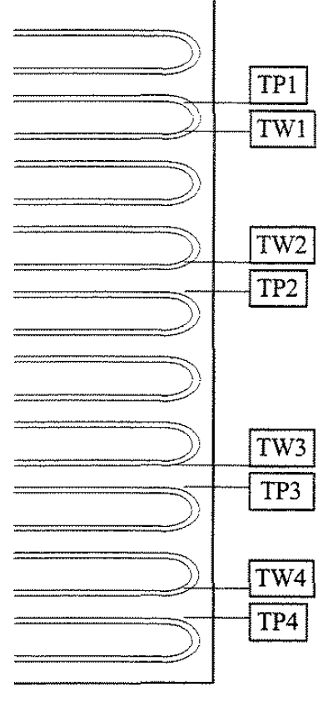
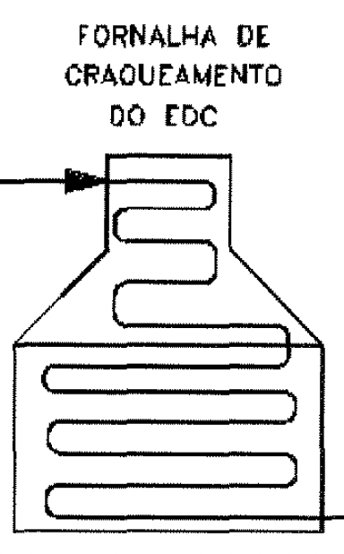
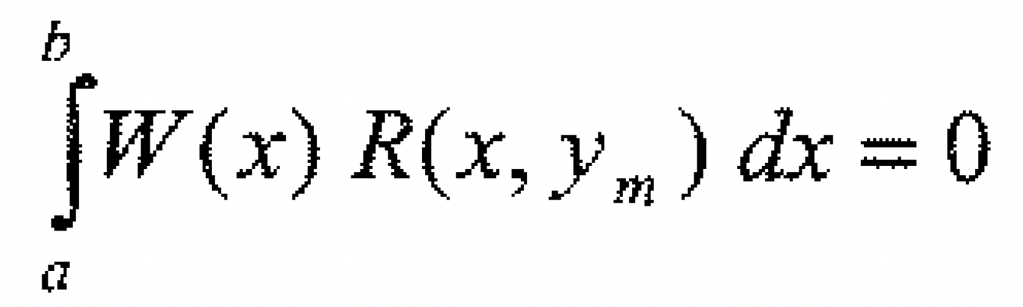
© Helianildes Silva Ferreira
The serpentines were furnace models and integrals!

Slide 9
How to model chemical processes in a furnace’s serpentines?
(A lot of) Fortran!

Slide 10
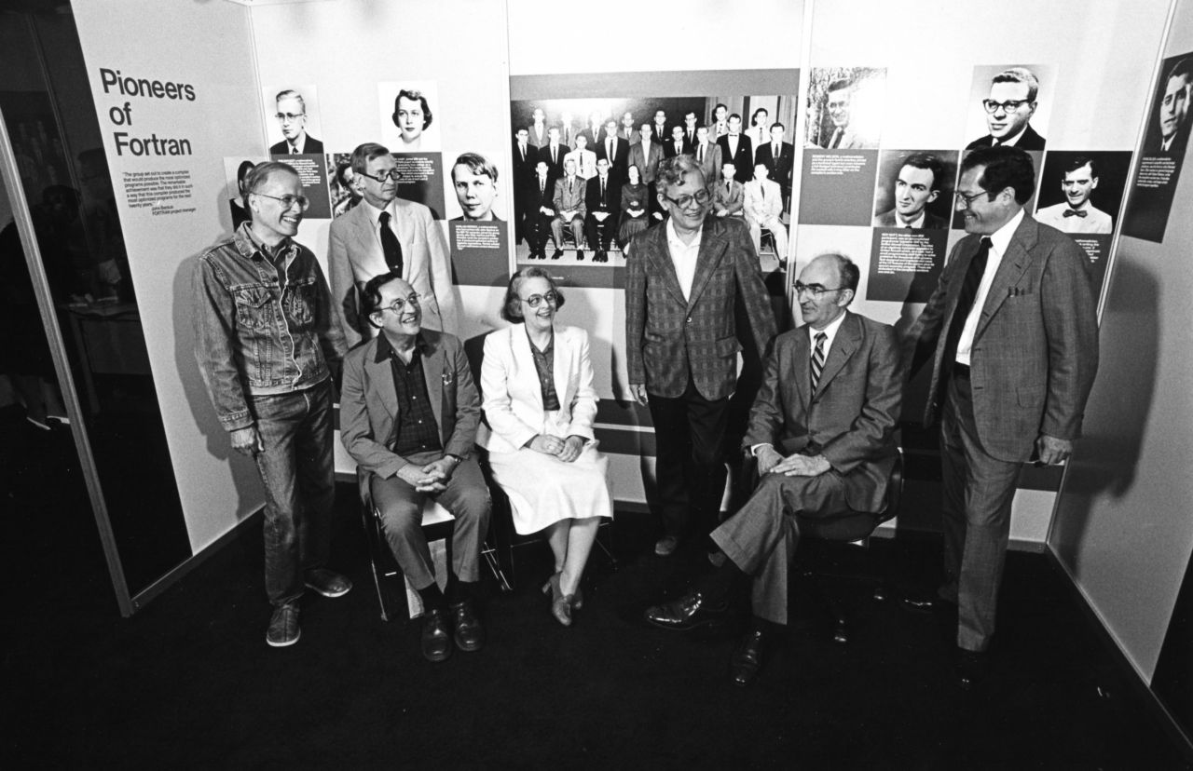
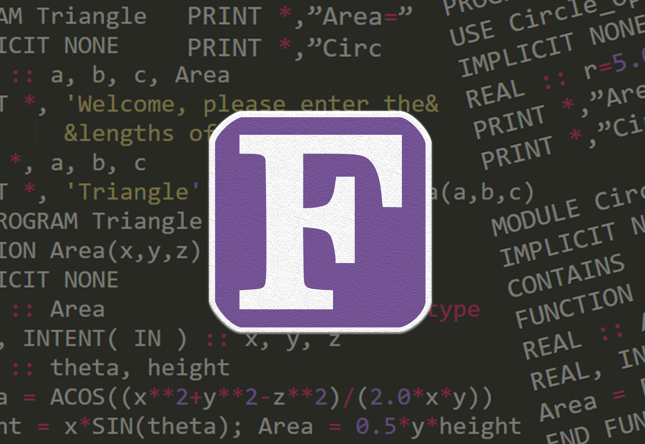
What is Fortran?

Slide 11
© IBM (History, Fortran)
Released by IBM in 1957, Fortran stands for Formula Translation

Slide 12
What is Fortran?

Slide 13
© Era Innovator (Fortran Programming Language)
Fast execution for numerical computations, popular in science and engineering.
Notes:
Scientific and engineering calculations
Fast execution for numerical computation
1st high-level widespread programming language
Legacy code in engineering, physics, chemistry, etc.

Slide 14
What is Fortran?

Slide 15
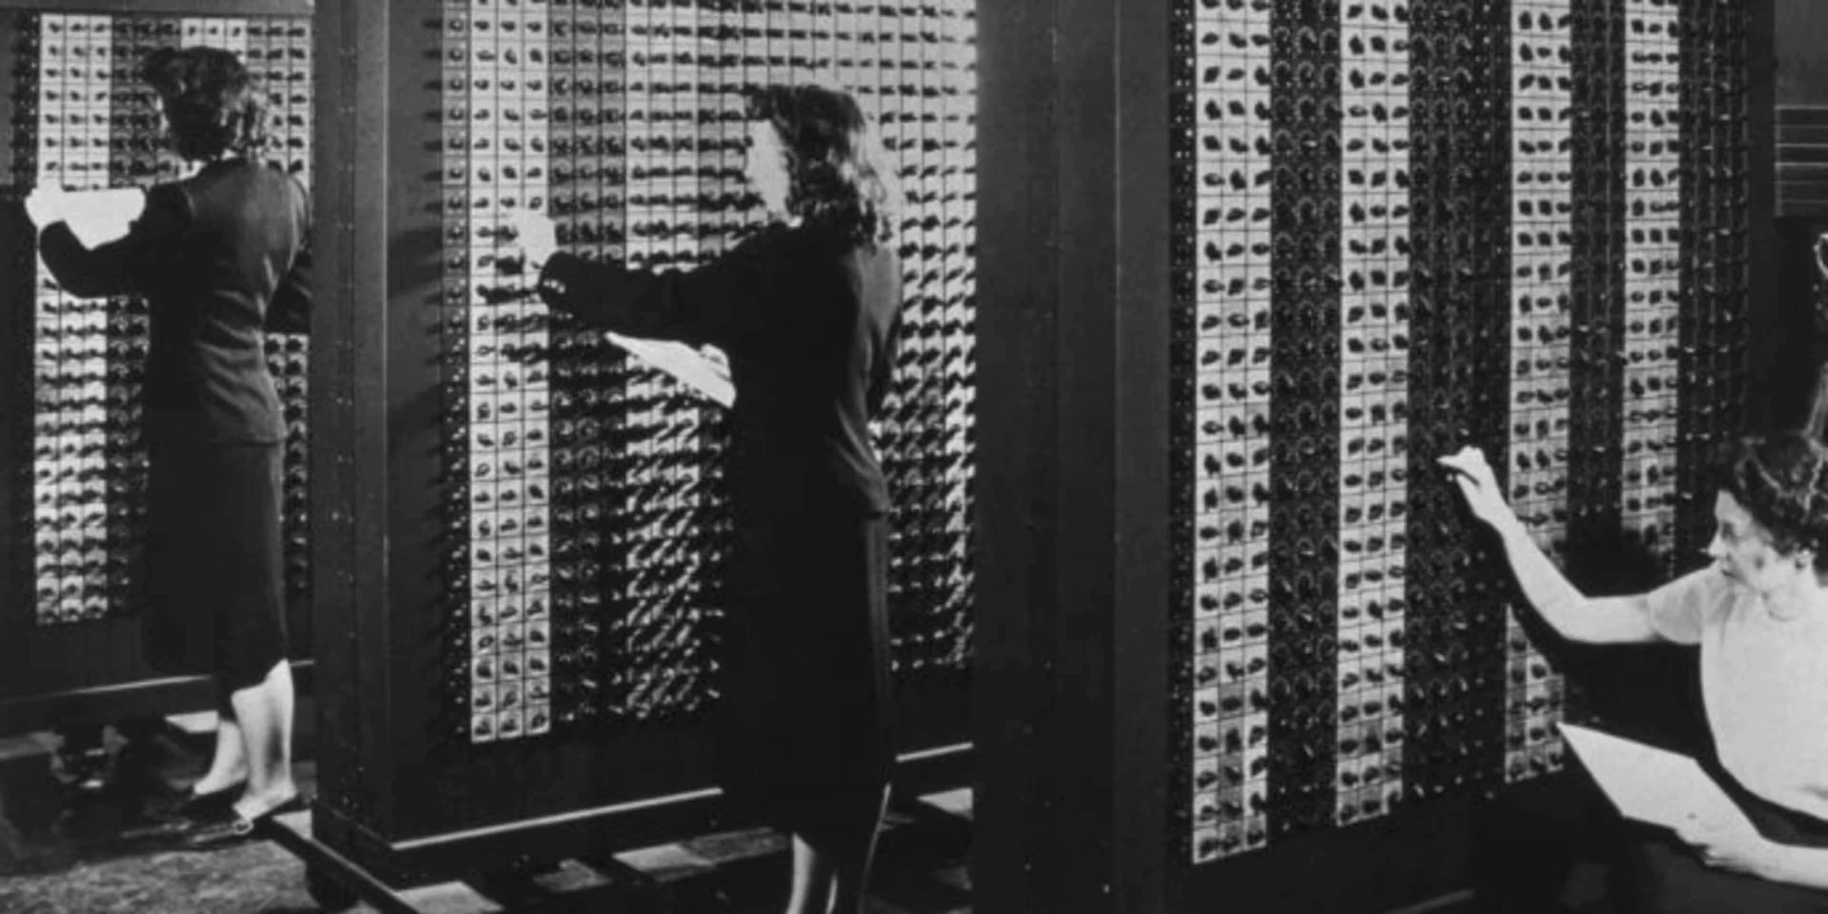
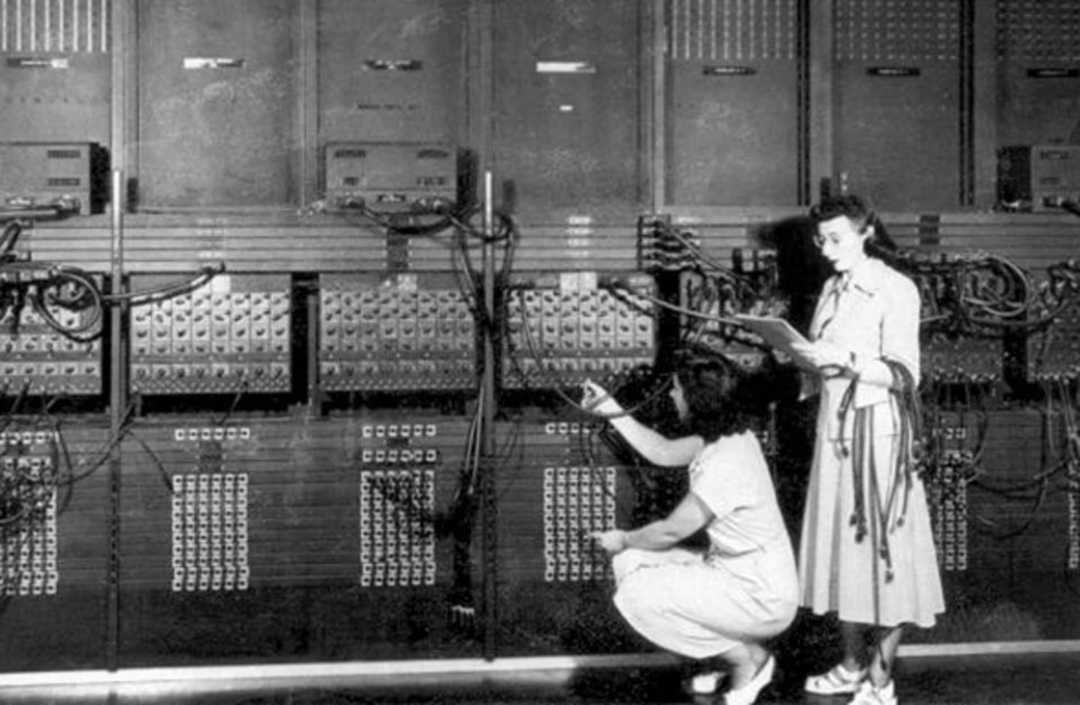
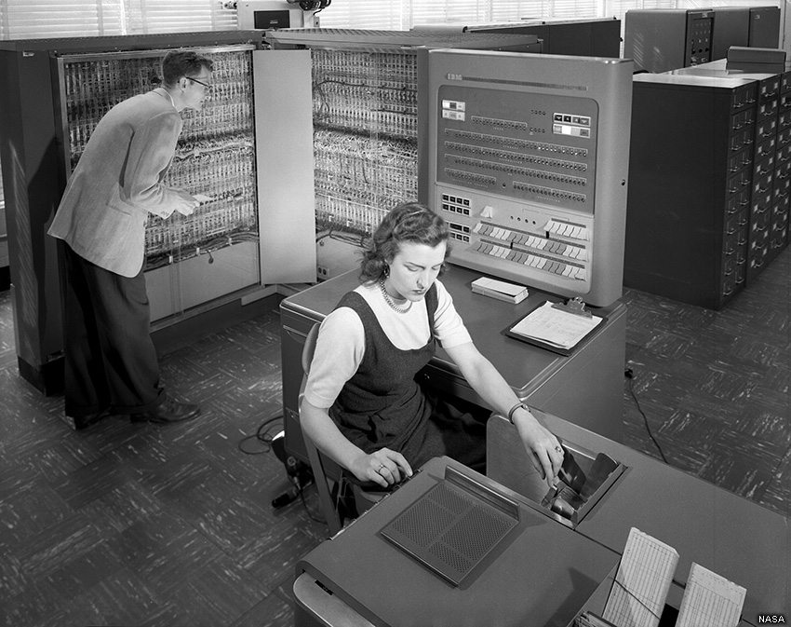
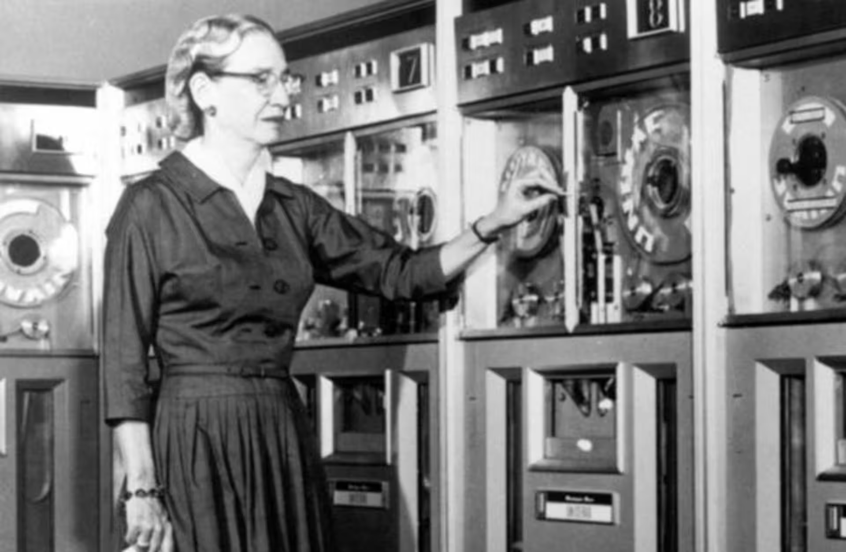
“Fortran-ladies”: often underpaid and undervalued

Slide 16
The Fortran-lady’s workflow (~1980s)
Write code on paper (no personal computers at home!)
After figuring out what to do with your children: go to university and type code in the computer
Line up to punch cards
Submit deck of punch cards to operator
Go home, make sure children are alive, and wait for the next day

Slide 17

Fortran vs. Python in Scientific Computing
Compiled performance
Optimized for loops
Used in legacy code
Ideal for simulations
Static typing
Easy to learn
Rich libraries
Slower loops
Great for orchestration
Widely adopted

Slide 18
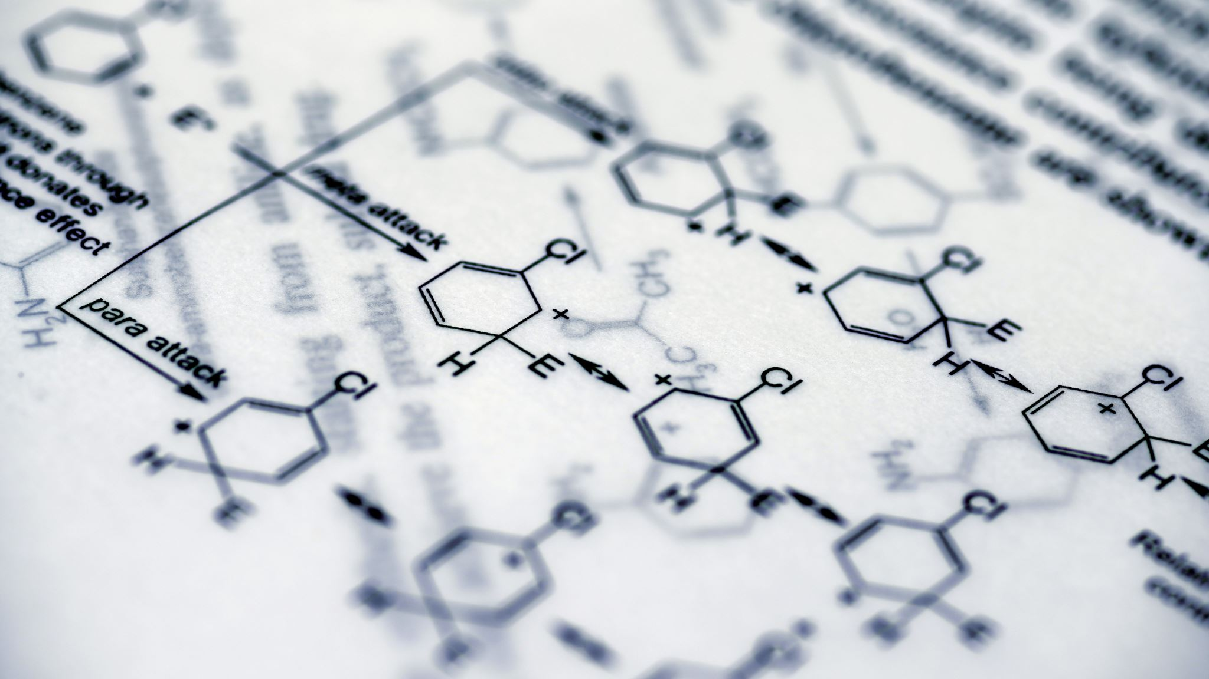
Chemical ODE Example

Slide 19
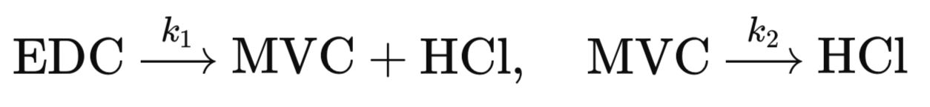
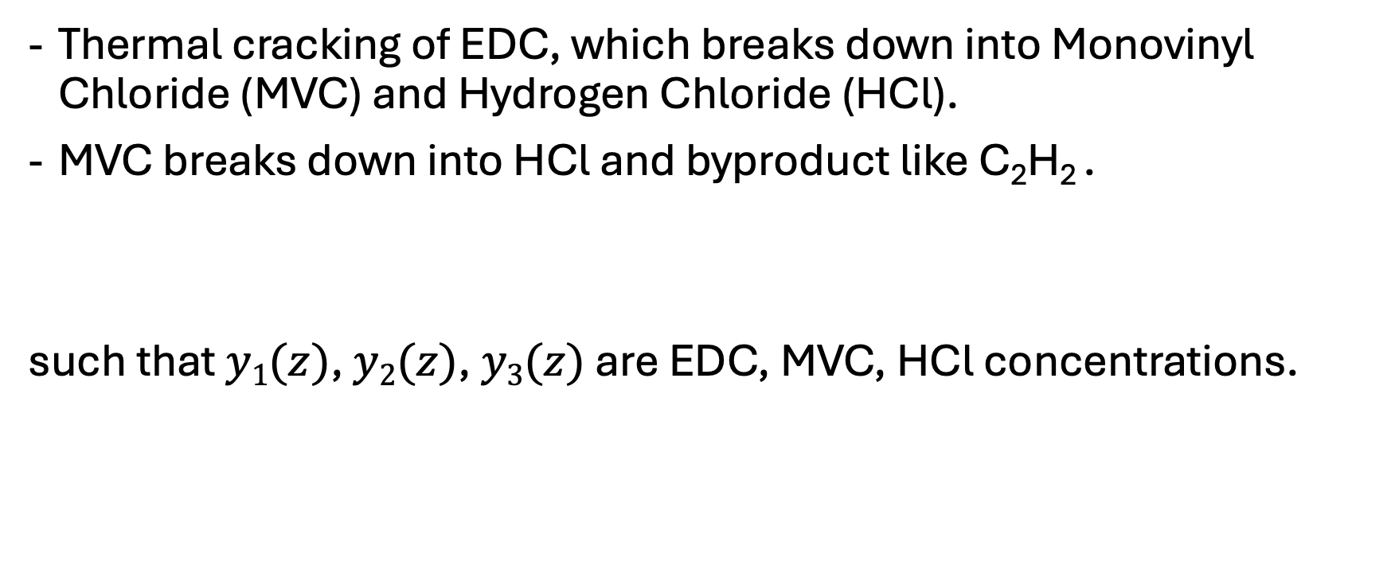
Modeling Thermal Cracking of Ethylene Dichloride (EDC)
Thermal cracking of EDC, which breaks down into Monovinyl Chloride (MVC) and Hydrogen Chloride (HCl).
MVC breaks down into HCl and byproduct like C₂H₂ .
such that $y1(z)$, $y2(z)$, $y3(z)$ are EDC, MVC, HCl concentrations.

Slide 20
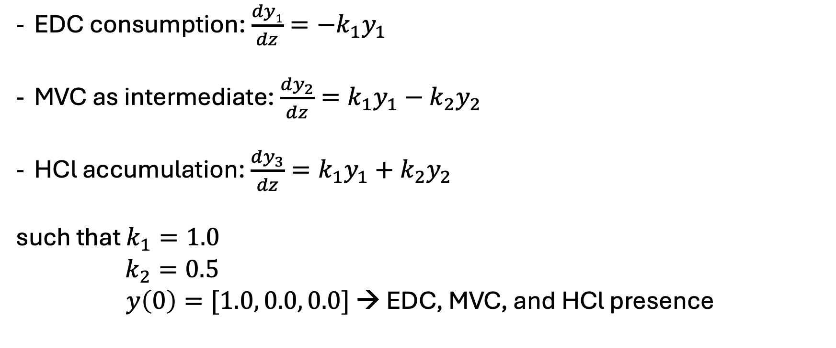
ODE System
EDC consumption: $\frac{dy1}{dz}=−k_{1}y_{1}$
MVC as intermediate: $\frac{dy_{2}}{dz}=k_{1}y_{1}−k_{2}y_{2}$
HCl accumulation: $\frac{dy_{3}}{dz}=k_{1}y_{1}+k_{2}y_{2}$
such that $k_{1}=1.0$
$k_{2}=0.5$
$y\left(0\right)=[1.0, 0.0, 0.0]$ → EDC, MVC, and HCl presence

Slide 21
Running Fortran in Python: step-by-step
1. Fortran code
We implemented the rk4g_solver subroutine in fortran-code.f90 to solve the system of ODEs using the Runge-Kutta-Gill method.
2. Compilation with f2py (Numpy)
`f2py -c fortran-code.f90 -m cracker`
3. Importing the compiled module in Python
`import cracker; cracker.rk4g_solver(n, h, y0)`
4. Usage in simulations and benchmarks
ftp.py: simulates EDC cracking and plots concentration profiles
Pyvsft-*.py: compare performance across different problem sizes

Slide 22
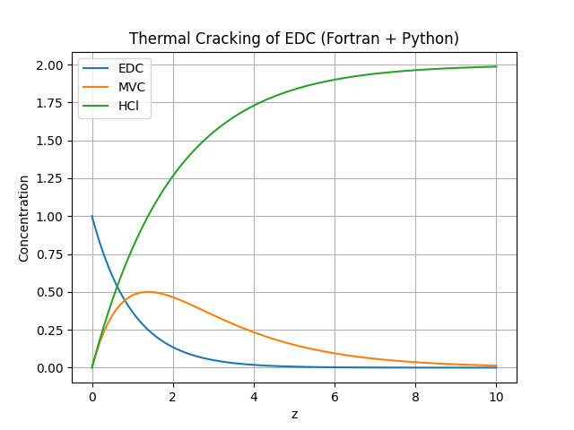
Results: Simulation

Slide 23
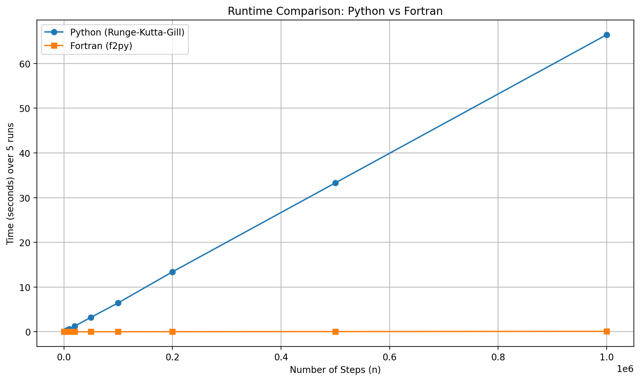
Results: Performance

Slide 24
Chemical ODE Simulation: Comparing Results
n | Fortran Time (ms) | Python Time (ms) | Speedup (x)
100 | 0 | 6.0 | 230.84
500 | 0 | 30.0 | 613.93
1000 | 0.1 | 60.0 | 570.25
2000 | 0.2 | 118.7 | 660.38
5000 | 0.4 | 302.1 | 680.40
10000 | 1.0 | 618.5 | 638.93
20000 | 1.8 | 1283.8 | 722.32
50000 | 4.5 | 3228.8 | 723.16
100000 | 9.7 | 6465.2 | 669.15
200000 | 19.3 | 13402.7 | 695.66
500000 | 48.8 | 33289.5 | 682.82
1000000 | 94.8 | 66422.6 | 700.39

Slide 25
Conclusions
Chemical Process Modeling We successfully modeled the thermal cracking of EDC using a system of ordinary differential equations based on chemical reaction kinetics. Model used is overly simplified.
Fortran Integration We implemented the solver in Fortran and used f2py to integrate it into Python, combining Fortran’s computational efficiency with Python’s flexibility.
Significant Speedup The Fortran version was up to ~700 times faster than the pure Python implementation, especially as the number of integration steps increased.
Python for Prototyping and Visualization Python proved to be an excellent environment for prototyping, data visualization using matplotlib, and benchmarking with timeit.
Key Takeaway This talk demonstrates the importance of selecting the right tool for the right problem.

Slide 26
The Big Picture: How have coding and scientific computing changed?

Slide 27
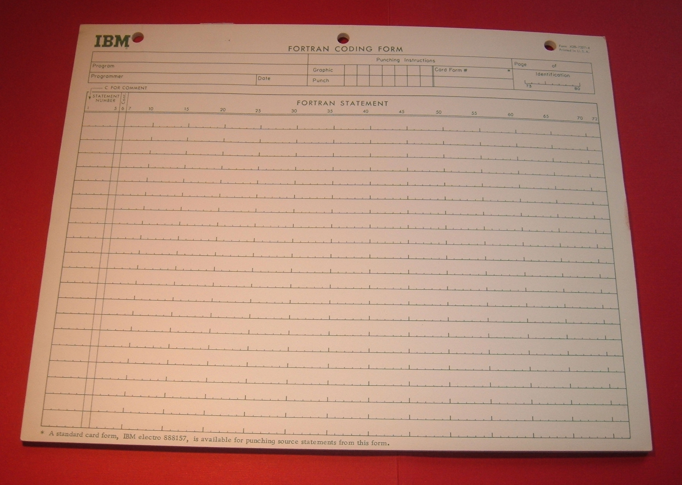
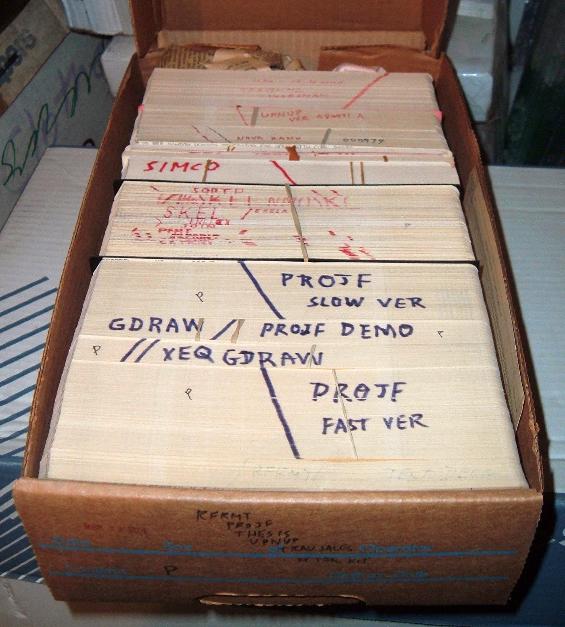
From Fortran times…
Figures resized from © Arnold Reinhold CC BY 2.0

Slide 28






… to Python notebooks and modern IDEs
© VS Code (Microsoft)
© Positron (Posit PBC)
© PyCharm (JetBrains)
+ AI/LLM Assistants
© Spyder
© Jupyter Notebooks
© Anaconda Navigator (Anaconda, Inc.)*
*Not an IDE or notebook itself, but a GUI that helps users explore, manage, and launch tools like IDEs and notebooks.

Slide 29
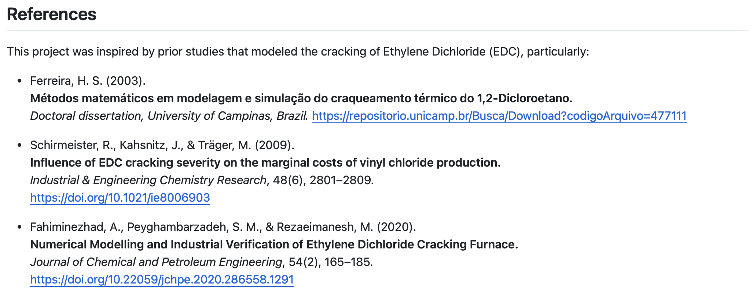

Thank you for attending!
GitHub Repo: https://github.com/rodrigosf672/pyohio2025-from_fortran_to_python
Questions?

Slide 30

Questions?

